Slide 1
How to work with transactions
Notes:
Transactions
In the last two chapters, you learned how to issue one database command at a time.
Now, you'll learn how to work with groups of related commands so none of the commands in the group are applied to the database unless all of the commands are.
This is an important skill for critical applications.

Slide 2
Notes:
2

Slide 3
Notes:
3
Transactions
In an Invoice Entry application you can add one invoice row to the Invoices table and one or more line item rows to the InvoiceLineltems table for each invoice that the user entered.
In a case like this, you want to be sure that all of the database commands for each invoice are executed successfully.
For instance, you don't want the invoice row to get added to the database unless the line item rows are added too. To prevent that from happening, you can use transactions.
A transaction is a group of related database commands that you combine into a single logical unit.
You can make sure that all of the commands in the transaction can be completed successfully before you commit them.
If one or more of the commands aren't done successfully, you can rollback all of the commands
The slide presents the methods you use to create and work with transactions.
To start a transaction, you use the BeginTransaction method of a connection object as shown in the first example in the slide. This creates a transaction object that you can use to work with the transaction.

Slide 4
Notes:
Transactions
Note that before you execute the BeginTransaction method, you must open the connection.
Also note that the SqlTransaction class doesn't have a public constructor. As a result, the only way to create a SqlTransaction object is to use the BeginTransaction method of the connection object.
To use a transaction, you associate it with one or more commands. To do that, you assign the transaction object to the Transaction property of each command as shown in the second and third examples on the slide.
Note that each of the commands must be associated with the same connection object on which the transaction was started.

Slide 5
Notes:
Transactions
After you associate a transaction with a command, any SQL statement you execute using that command becomes part of the transaction.
If all of the commands in the transaction execute without error, you can commit the transaction. That means that all of the changes that have been made to the database since the beginning of the transaction are made permanent.
To commit a transaction, you use the Commit method of the transaction as shown in the slide.
In contrast, if any of the commands cause an error, you can reverse, or rollback, all of the changes made to the database since the beginning of the transaction.
To rollback a transaction, you use the Rollback method of the transaction as shown in the last example on the slide.

Slide 6
Methods of the SqlTransaction class for working with save points
Save(savePointName)
Rollback(savePointName)
Notes:
6
Transactions – Save points
In most cases, if you need to rollback a transaction, you'll rollback the entire transaction.
Occasionally, though, you may need to rollback just part of a transaction. To do that, you use save points as illustrated on the slide.
To set a save point, you use the Save method of the transaction. On this method, you specify the name you want to use for the save point.
To roll a transaction back to a save point, you name the save point on the Rollback method.

Slide 7
Notes:
Transactions – Save points
The example on the slide illustrates how this works. The code in this example starts by creating a command that contains a Delete statement that deletes the vendor with a specified ID. This command is associated with a transaction named vendorTransaction.

Slide 8
Notes:
Transactions – Save points
The next group of statements deletes the vendor with a vendor ID of 126 and then sets a save point named Vendor 1.
The next group of statements is similar except that it deletes the vendor with a vendor ID of 127 and then sets a save point named Vendor2.
The two statements after that delete the vendor with a vendor ID of 128.
The next statement rolls back the transaction to the Vendor2 save point. That means that any processing that was done after the Vendor2 save point is rolled back, which means that the third delete operation is rolled back.
The next statement rolls back the transaction to the Vendor 1 save point, which rolls back the second delete operation.
Finally, the transaction is committed.
Since the only delete operation that hasn't already been rolled back is the one that deleted row 126, this row is deleted permanently.

Slide 9
Notes:
9
Concurrency problems
When two or more users have access to the same database, it's possible for them to be working with the same data at the same time. This is called concurrency.
Concurrency isn't a problem when two users retrieve the same data at the same time.
If they then try to update that data, however, that can be a problem.
In the topics that follow, you'll learn how SQL Server uses locking to prevent concurrency problems. You'll also learn how you can control the types of problems that are allowed.
The slide describes the four types of concurrency problems that locks can prevent.
Depending on the nature of the data you're working with, these problems may not adversely affect a database.
In fact, for many systems, these problems happen infrequently. When they do occur, they can be corrected by simply resubmitting the query that caused the problem.
On some database systems, however, these problems can affect data integrity in a serious way.
Lost updates
Occur when two transactions select the same row and then update the row based on the values originally selected.
Since each transaction is unaware of the other, the later update overwrites the earlier update.
Dirty reads
Occur when a transaction selects data that isn't committed by another transaction.
For example, transaction A changes a row. Transaction B then selects the changed row before transaction A commits the change.
If transaction A then rolls back the change, transaction B has selected a row that doesn't exist in the database.
Nonrepeatable reads
Occur when two Select statements of the same data result in different values because another transaction has updated the data in the time between the two statements.
For example, transaction A selects a row. Transaction B then updates the row. When transaction A selects the same row again, the data is different.
Phantom reads
Occur when you perform an update or delete on a set of rows when another transaction is performing an insert or delete that affects one or more rows in that same set of rows.
For example, transaction A updates the payment total for each invoice that has a balance due. Transaction B inserts a new, unpaid, invoice while transaction A is still running.
After transaction A finishes, there is still an invoice with a balance due.
To help prevent concurrency problems, SQL Server uses locking.
In most cases, the default locking behavior prevents serious data integrity problems from occurring.
In some cases, though, you may want to change the default locking behavior. ADO.NET lets you do that by setting the transaction isolation level.

Slide 10
Members of the IsolationLevel enumeration
Member | Description
ReadUncommitted | Allows all concurrency problems
ReadCommitted | Prevents dirty reads, but not nonrepeatable reads or phantom reads. This is the default for SQL Server
RepeatableRead | Prevents dirty reads and nonrepeatable reads, but not phantom reads
Snapshot | Prevents all concurrency problems by using row versioning instead of locking
Serializable | Prevents all concurrency problems
Notes:
10

Slide 11
Notes:
11
Concurrency problems
The slide shows how you change the transaction isolation level for a transaction.
You specify the isolation level on the BeginTransaction method using one of the members of the IsolationLevel enumeration.
The table on the previous slide indicates which of the four concurrency problems an IsolationLevel will prevent or allow.
For example, if you set the isolation level to Serializable as shown in the statement on the slide, all four concurrency problems will be prevented.
When you set the isolation level to Serializable, each transaction is completely isolated from every other transaction and concurrency is severely restricted.
The server does this by locking each resource, preventing other transactions from accessing it.
Since each transaction must wait for the previous transaction to commit, the transactions are executed serially, one after another. Since the Serializable isolation level eliminates all possible concurrency problems, you may think that this is the best option.
However, this option requires more server overhead to manage all of the locks. In addition, access time for each transaction is increased, since only one transaction can work with the data at a time. For most systems, this will actually eliminate few concurrency problems but will cause severe performance problems.
The lowest isolation level is ReadUncommitted, which allows all four of the concurrency problems to occur.
It does this by performing Select queries without setting any locks and without honoring any existing locks.
Since this means that your Select statements will always execute immediately, this setting provides the best performance.
Since other transactions can retrieve and modify the same data, however, this setting can't prevent concurrency problems.
The default isolation level, ReadCommitted, is acceptable for most applications.
However, the only concurrency problem it prevents is dirty reads. Although it can prevent some lost updates, it can't prevent them all.
The RepeatableRead level allows more concurrency than the Serializable level but less than the ReadCommitted level.
As you might expect, it results in faster performance than Serializable and permits fewer concurrency problems than ReadCommitted.
The Snapshot level uses a SQL Server feature called row versioning.
With row versioning, any data that's retrieved by a transaction that uses Snapshot isolation is consistent with the data that existed at the start of the transaction.
To accomplish that, SQL Server maintains a snapshot of the original version of a row each time it's modified.
When you use row versioning, locks aren't required for read operations, which improves concurrency.
However, the need to maintain row versions requires additional resources and can degrade performance.
In most cases, then, you'll use row versioning only when data consistency is imperative.

Slide 12
Demo:
A Transfer Payment application that uses Transactions
(Source Code: wpfTransferPaymentDemo : BlackBoard)
Notes:
Demo
To illustrate the use of transactions, the demo presents a simple application.
It lets the user reverse an incorrect invoice payment and apply the payment to the correct invoice.
For each transfer, a transaction is used to make sure that a payment isn't reversed unless it is also applied to the correct invoice.

Slide 13
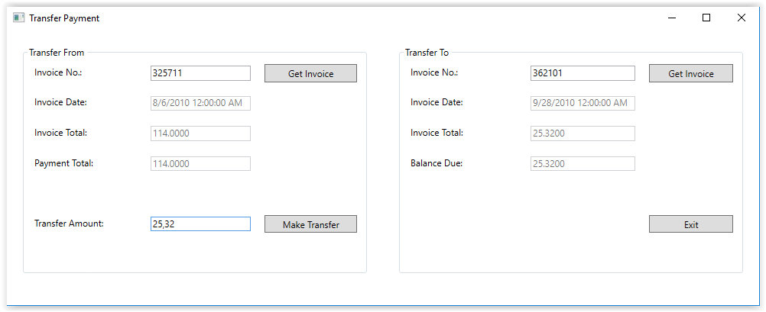
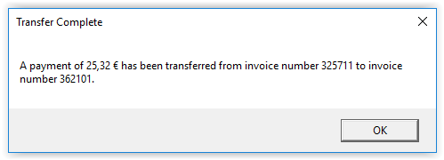
Notes:
13

